Slide 1
Tactio Project Proposal By team Touché
Austin Keener
Joseph Spall
Joshua Oldenburg
Juan Elizondo-Villasis
Varun Madabushi

Slide 2
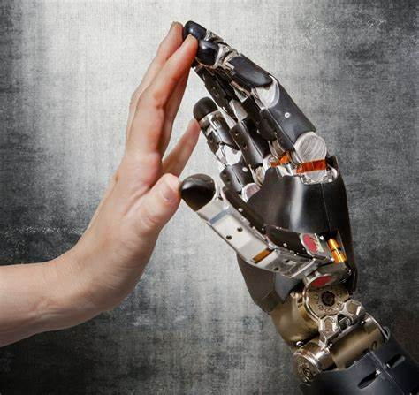
Introduction
Humans rely heavily on their tactile senses to understand the weight, shape, and texture of the objects they hold
Robots require tactile sensors to measure contact forces with objects they interact with
Tactile sensing can enable robots to more effectively grasp and interact with objects in the real world
Notes:
image source: https://66.media.tumblr.com/36827f760bb92ab2f2fac3225450c3bf/tumblr_muoh2oO6nr1qhejy8o1_640.jpg

Slide 3
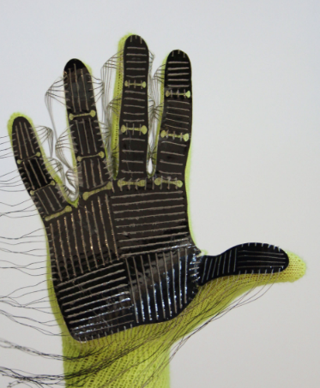
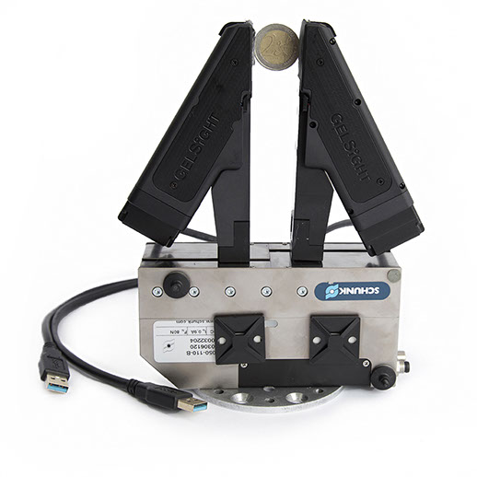
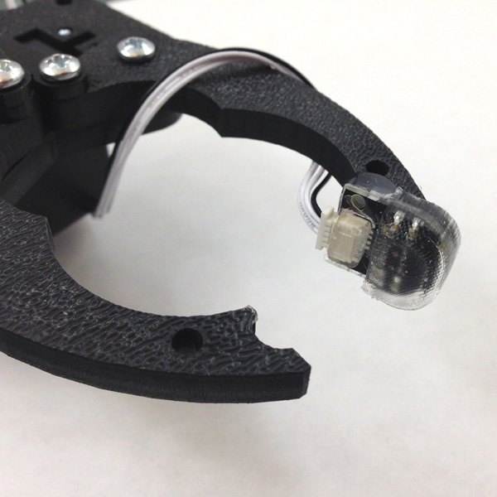
Problems with Existing Solutions
STAG | Optical Sensors (GelSight) | SparkfunX Finger Sensor
Many Wires Complex manufacturing method Market availability | High Cost Small sensing area Market availability | Small sensing area Cannot locate contact force
Notes:
The existing products do not serve

Slide 4
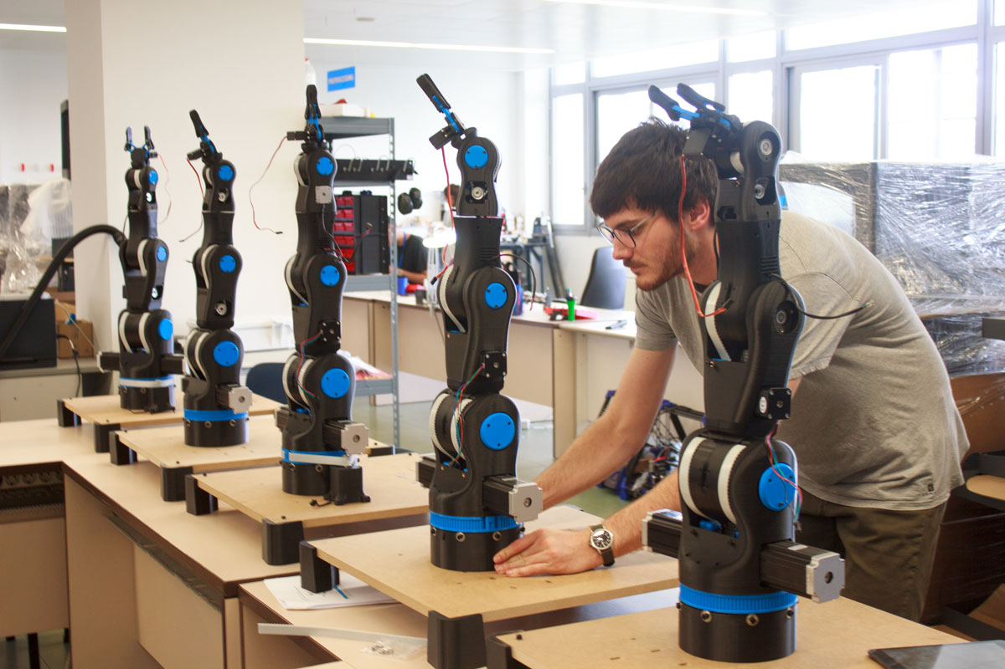
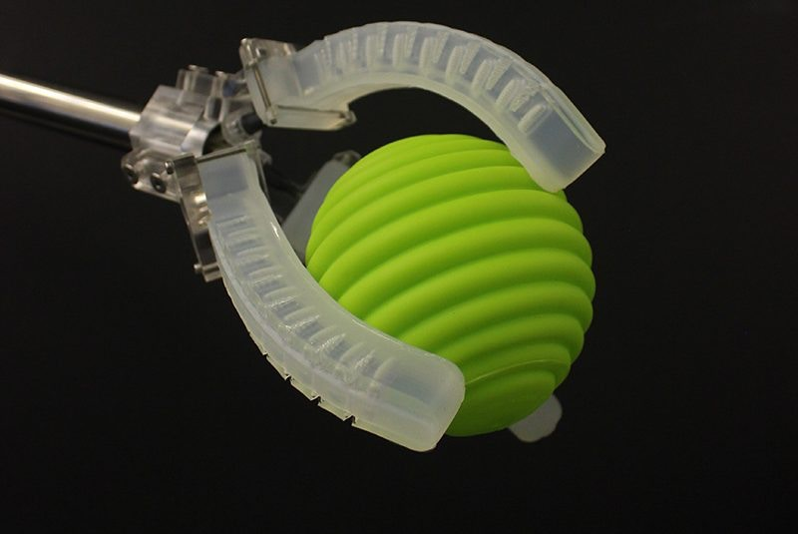
Target Audience
Our goal is to develop a platform for rapid development and prototyping of tactile sensing solutions
Three target communities can benefit
Researchers
Students
Hobbyists
Notes:
https://www.therobotreport.com/

Slide 5
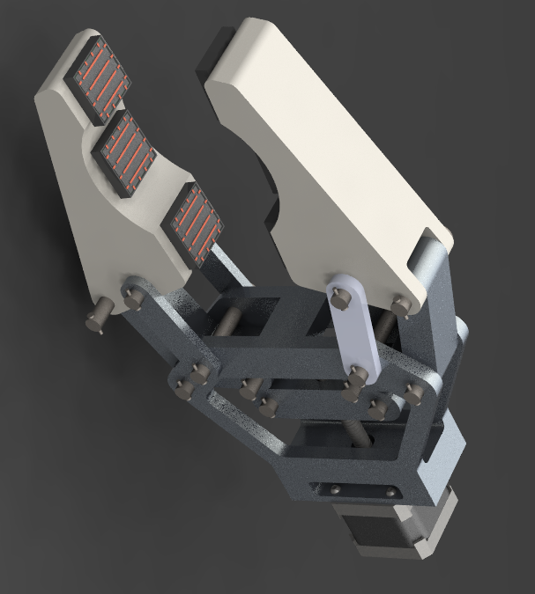
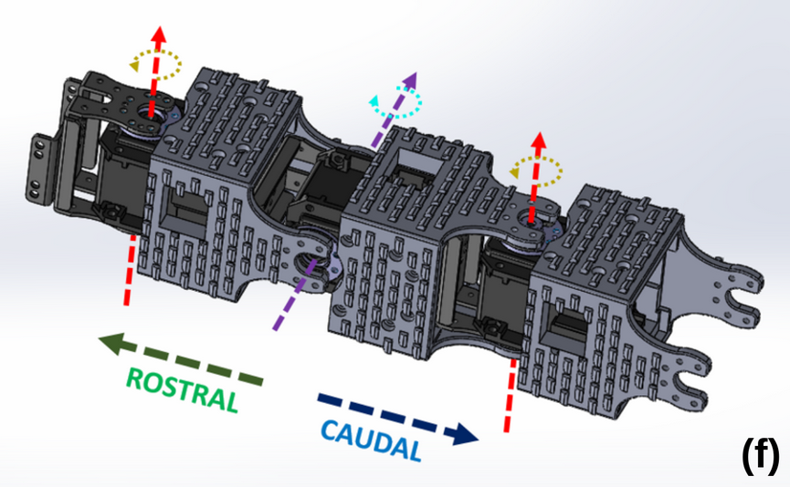
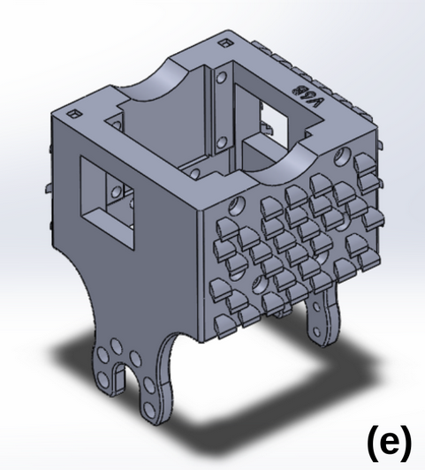
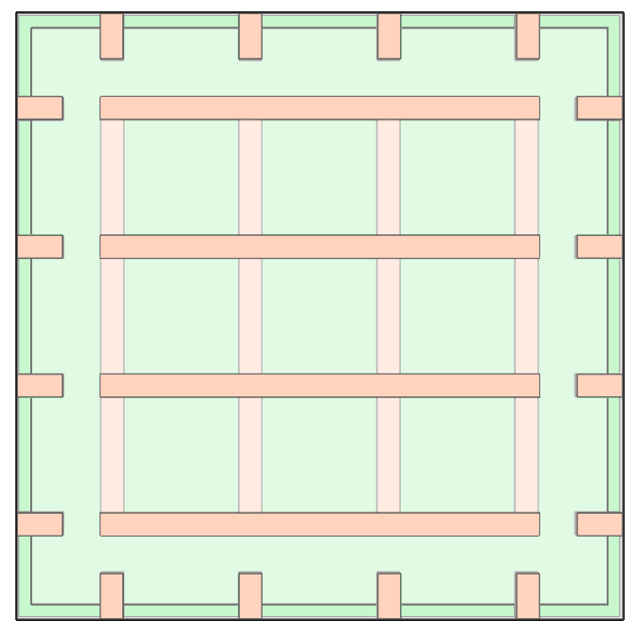
Design Goals
Chainable modular sensor units
Simplifies design and wiring for users
Flexible mounting configurations
Can be easily retrofitted onto existing robots
Easy third-party integration
Compatible with popular ecosystems for electronics prototyping

Slide 6
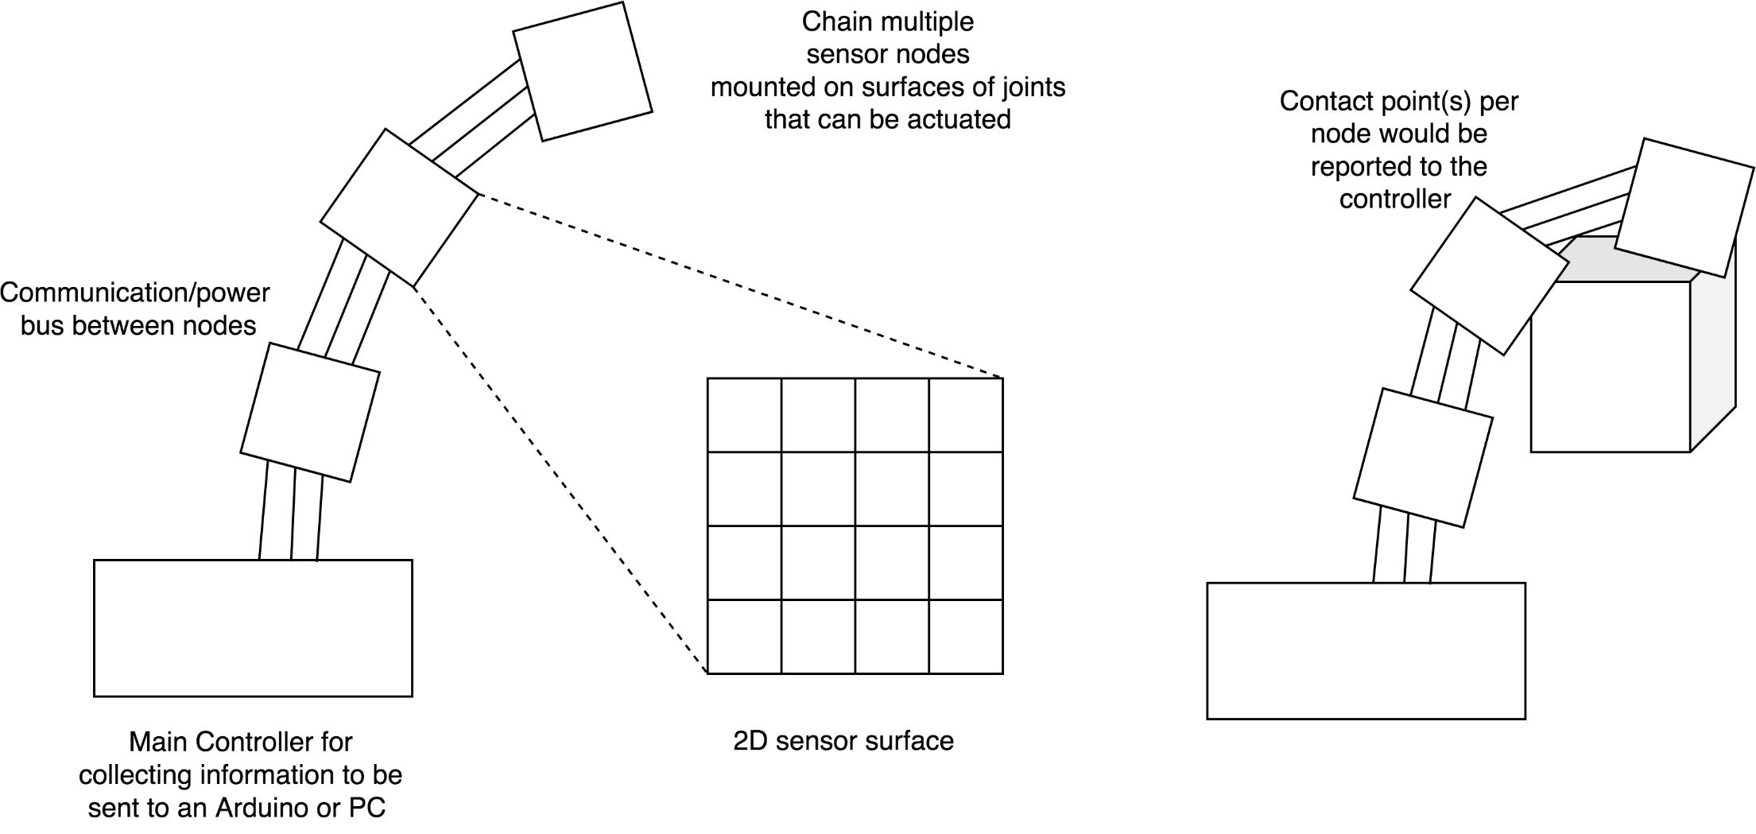
Design Concept

Slide 7
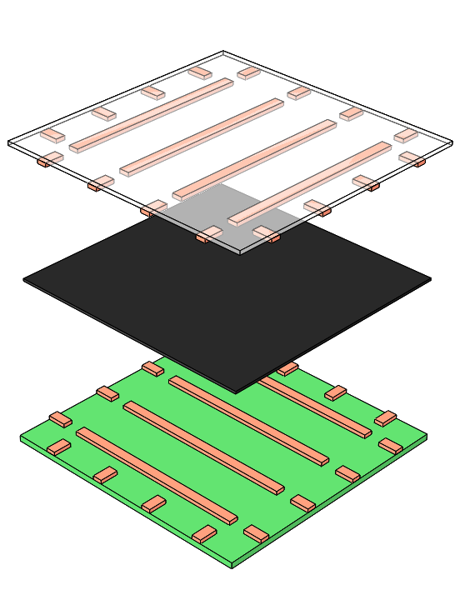
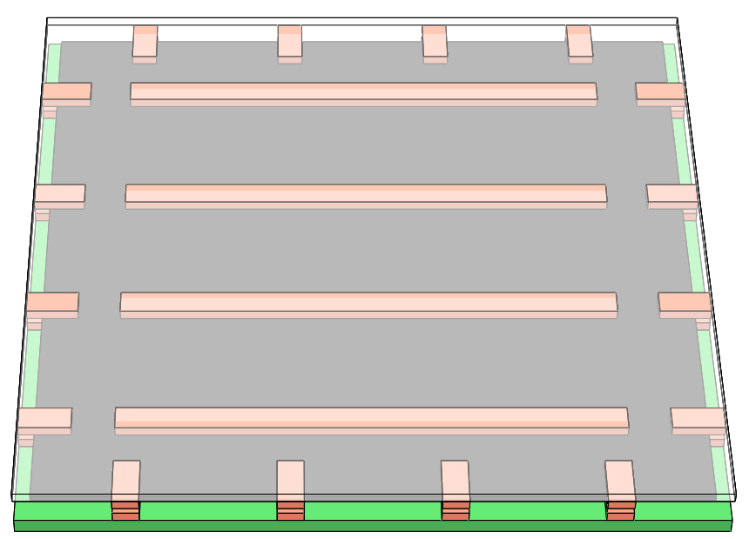
Sensing Solution
Flex PCB allows film to deform
Piezoresistive film (Velostat) changes resistance with strain
Row-column pattern allows reading in 16 different points

Slide 8
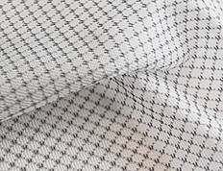
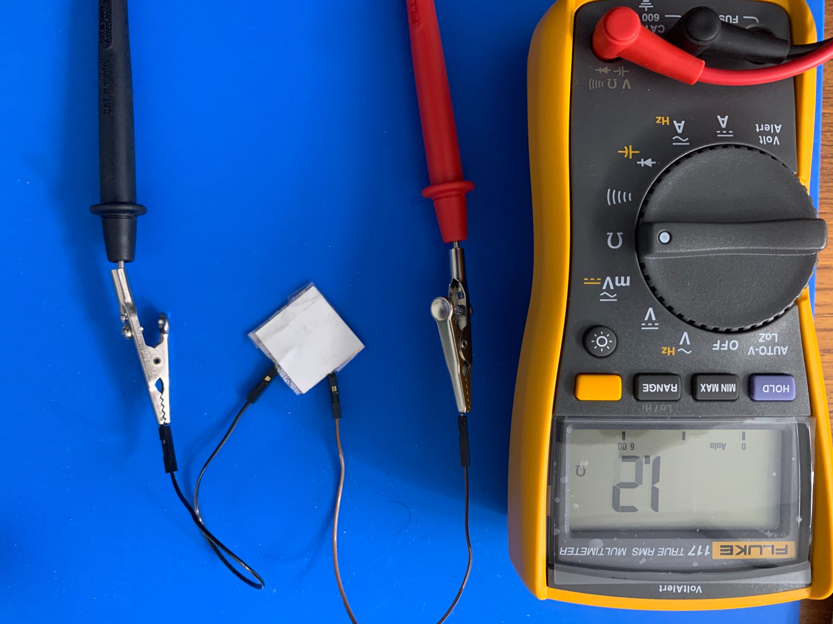
Design Alternatives - Materials
EX-STATIC
Thin, inexpensive, and flexible conductive fabric
Good force localization
Poor magnitude response due to high conductivity
Not compatible with stacked design due to very low resistance with no added strain
Easy to short between fabric fibers

Slide 9
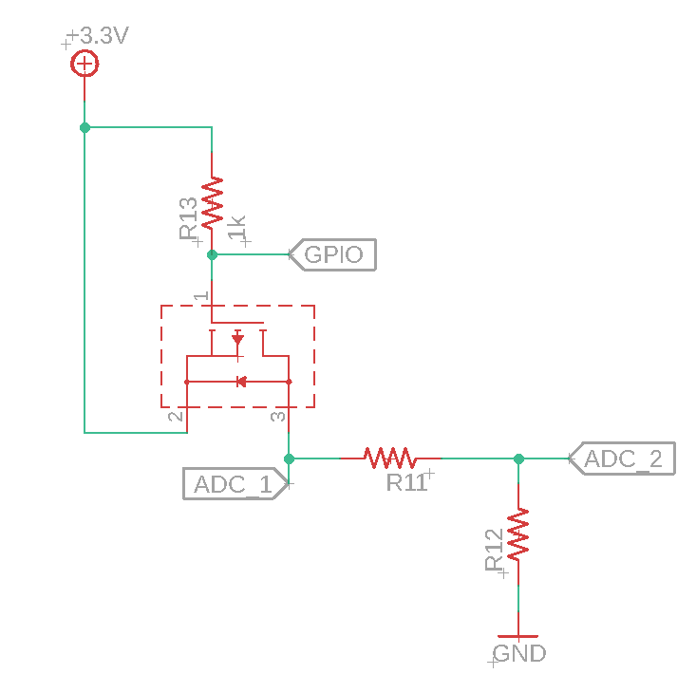
Rigid PCB Circuits
Velostat film
= R11
MOSFET switches each column on to create this circuit with each row

Slide 10
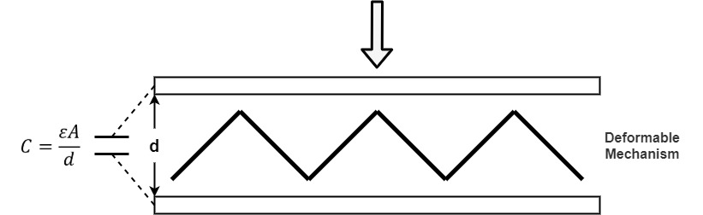
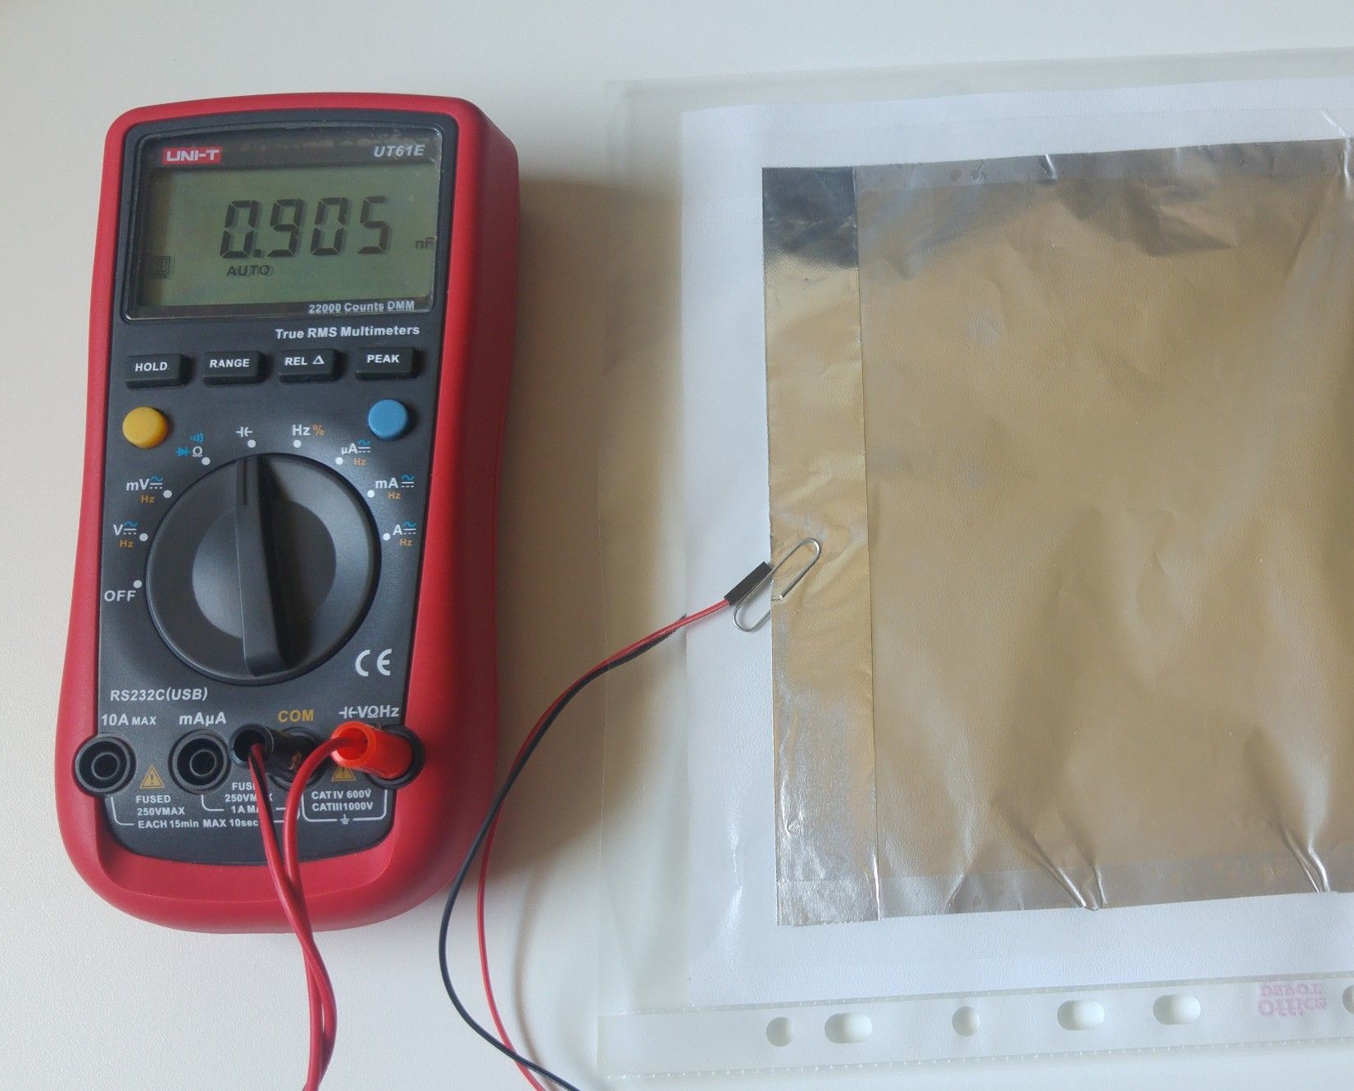
Design Alternatives - Sensing
Capacitive- Based on separation distance of two conductive elements
Good noise immunity
Relatively expensive
Only works with certain materials

Slide 11
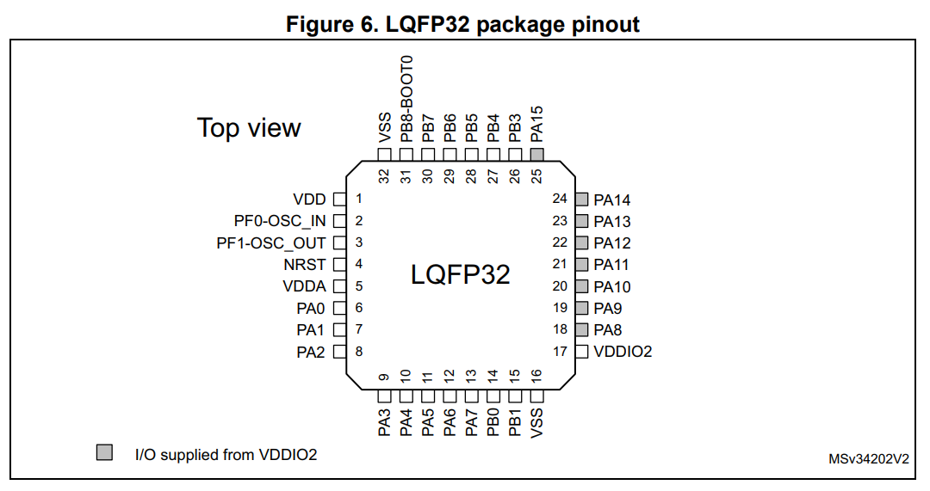
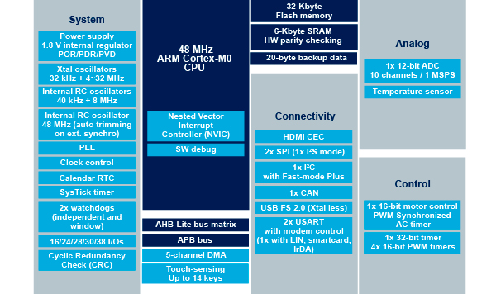
Microcontroller Selection
STM32F042 Features
STM32F042 selected based on required peripherals (CAN and ADC), memory, cost, and pin count
Notes:
Images taken from https://www.st.com/resource/en/datasheet/stm32f042k6.pdf
https://www.st.com/en/microcontrollers-microprocessors/stm32f042k6.html#overview

Slide 12


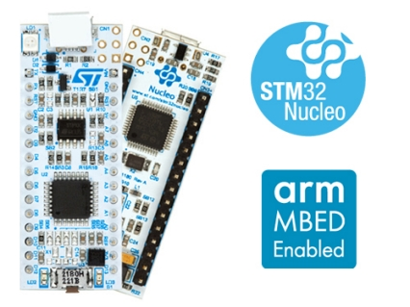
Firmware Solution
Microcontroller running C++ code for measurement and communication
Planning to use Mbed OS 2, with STM32Cube as a fallback
Notes:
Logos from https://os.mbed.com/ and https://www.st.com/content/st_com/en/stm32cube-ecosystem.html
Image from https://www.st.com/content/st_com/en/products/evaluation-tools/product-evaluation-tools/mcu-mpu-eval-tools/stm32-mcu-mpu-eval-tools/stm32-nucleo-boards/nucleo-f042k6.html#overview

Slide 13
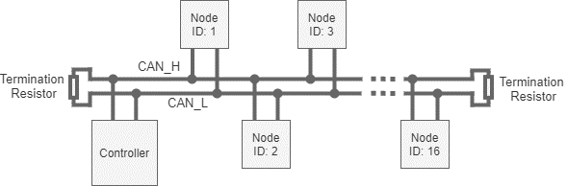
Communications
Utilizes CAN 2.0, a multi-master 2-wire serial bus
Up to 255 individually addressed nodes with automatic or user-controlled addressing
Network controller manages network and polls sensors

Slide 14
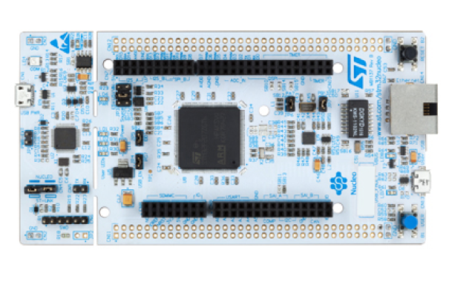
Design Alternatives - Communications
Daisy-Chained UART
UART
UART2
UART2
Controller
Node 1
Node 2
Node 3
UART1
UART1
Advantages | Concerns
Automatic position-based node addressing | Requires custom peripheral implementation in firmware
No transceiver required | Requires timing coordination

Slide 15
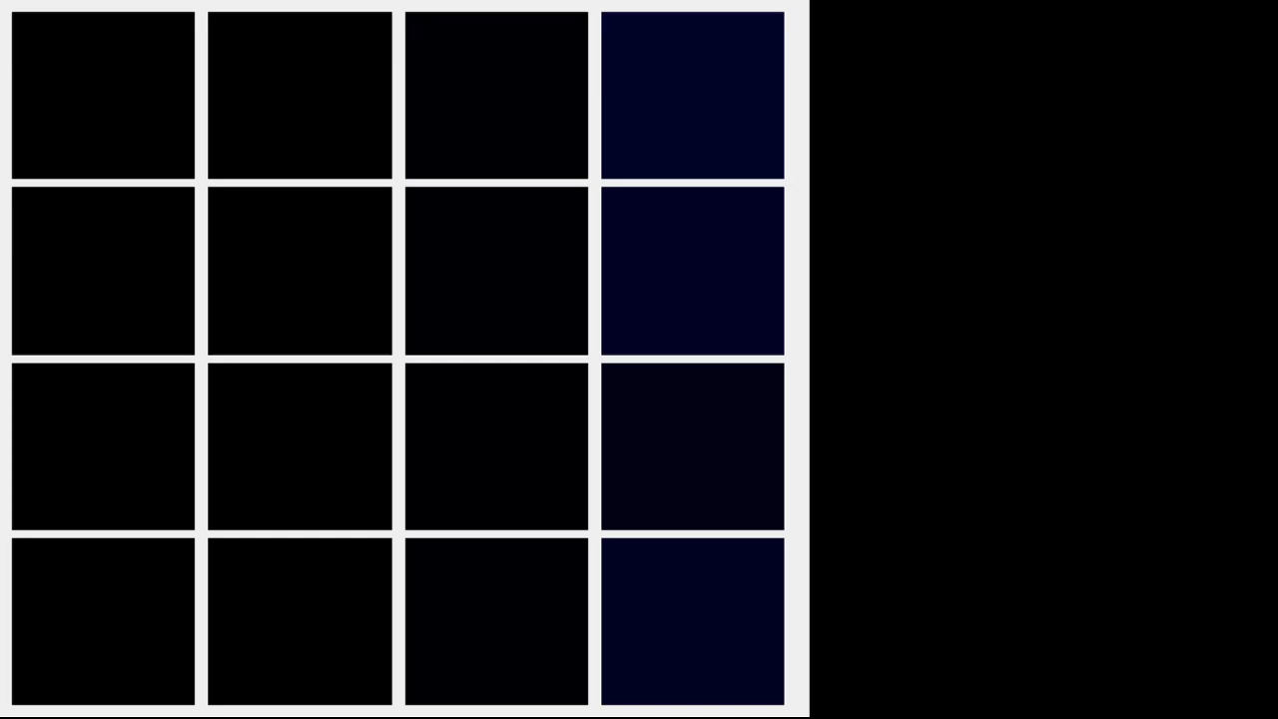
Software Solution
We will provide code to run on an Mbed development board to act as a CAN to USB bridge
Desktop library to interact with and visualize the sensor
Notes:
Image source: https://www.st.com/content/st_com/en/products/evaluation-tools/product-evaluation-tools/mcu-mpu-eval-tools/stm32-mcu-mpu-eval-tools/stm32-nucleo-boards/nucleo-f042k6.html#overview

Slide 16
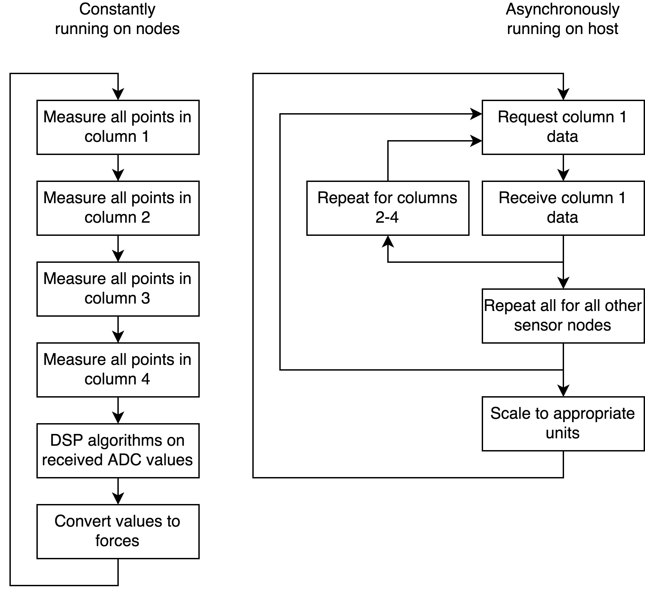
Analysis Flow
Due to packet size, single sensor readings are split into multiple frames
Polling
Allow sensors to stabilize
Lower RAM requirements of host for reconstruction

Slide 17
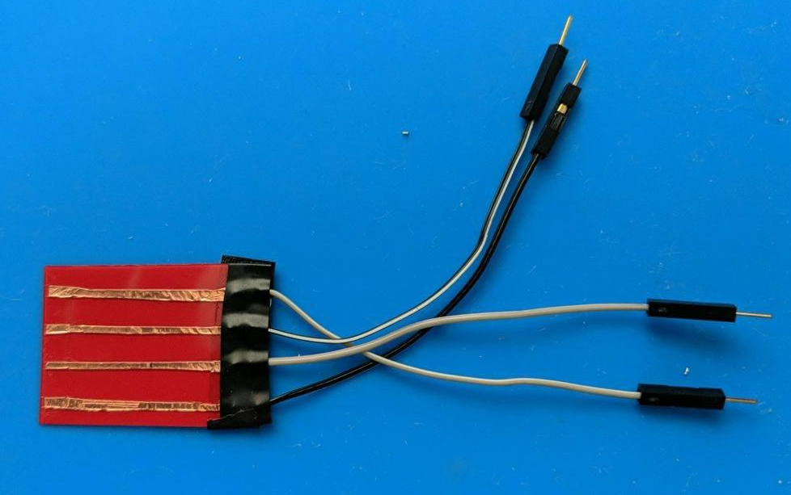
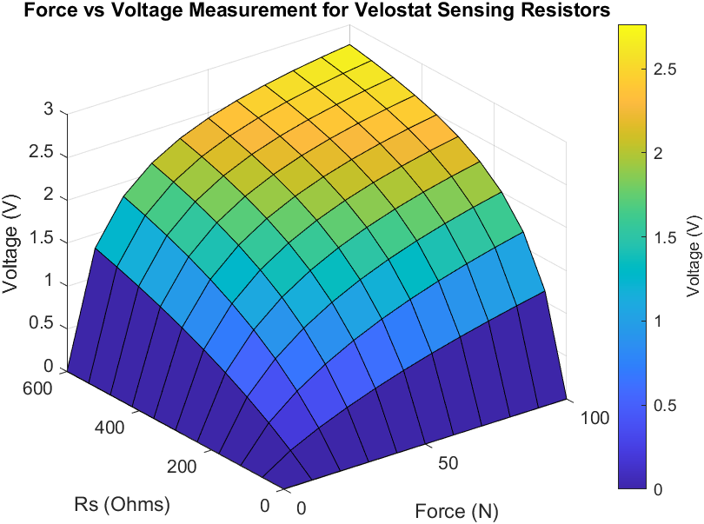
Current Status - Electrical / Materials
Prototyped sensor
2x flexible plastic sheet with 4 copper tape rows
Velostat in the middle
Stack taped together at 90 deg angle
Modeling of Velostat for ADC range

Slide 18
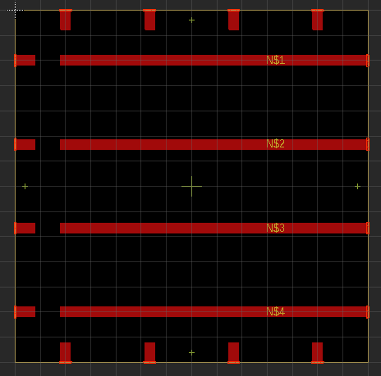
Current Status - Electrical
Flex PCB
Designed in Autodesk EAGLE
Perimeter tabs for soldered mounting
Rows for connection to rigid PCB
Will be ordered when rigid is finished

Slide 19
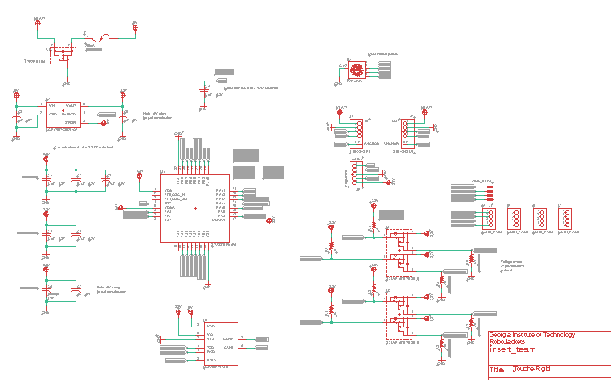
Current Status - Electrical
Rigid PCB
Designed in Autodesk EAGLE
Schematic nearing completion
Major components
STM32F0 MCU
Communication
Power
Safety
Driving Circuits

Slide 20
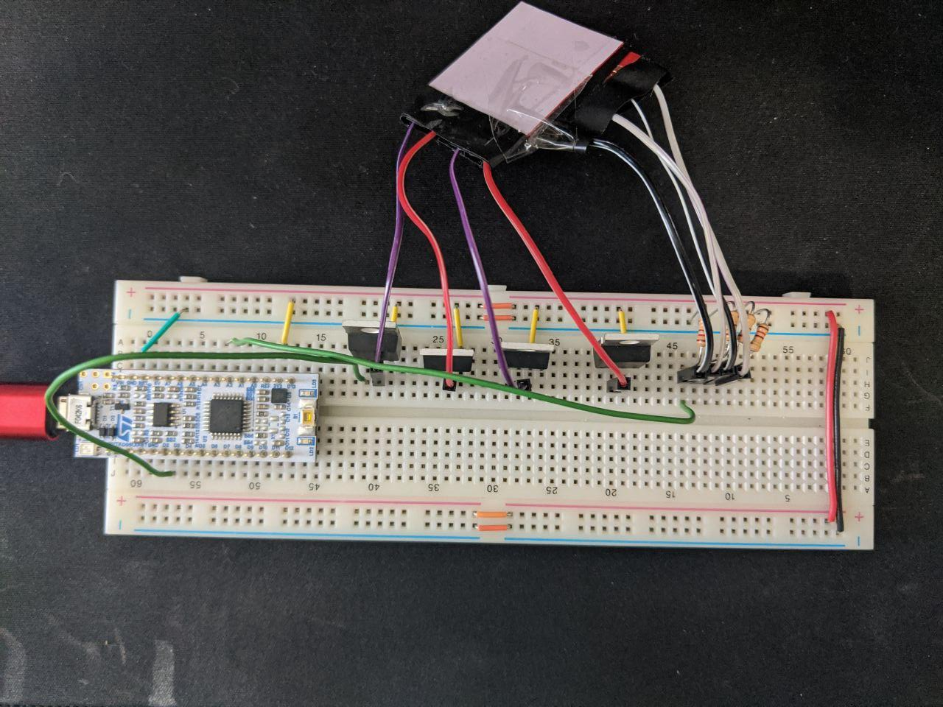
Current Status - Electrical / Firmware
Bread-boarded circuit mimicking rigid PCB + flex PCB design
Wrote firmware to test...
Reading Velostat with ADCs
Driving rows with PFETs
Printing to screen
Driving PFETs
STM32 MCU

Slide 21
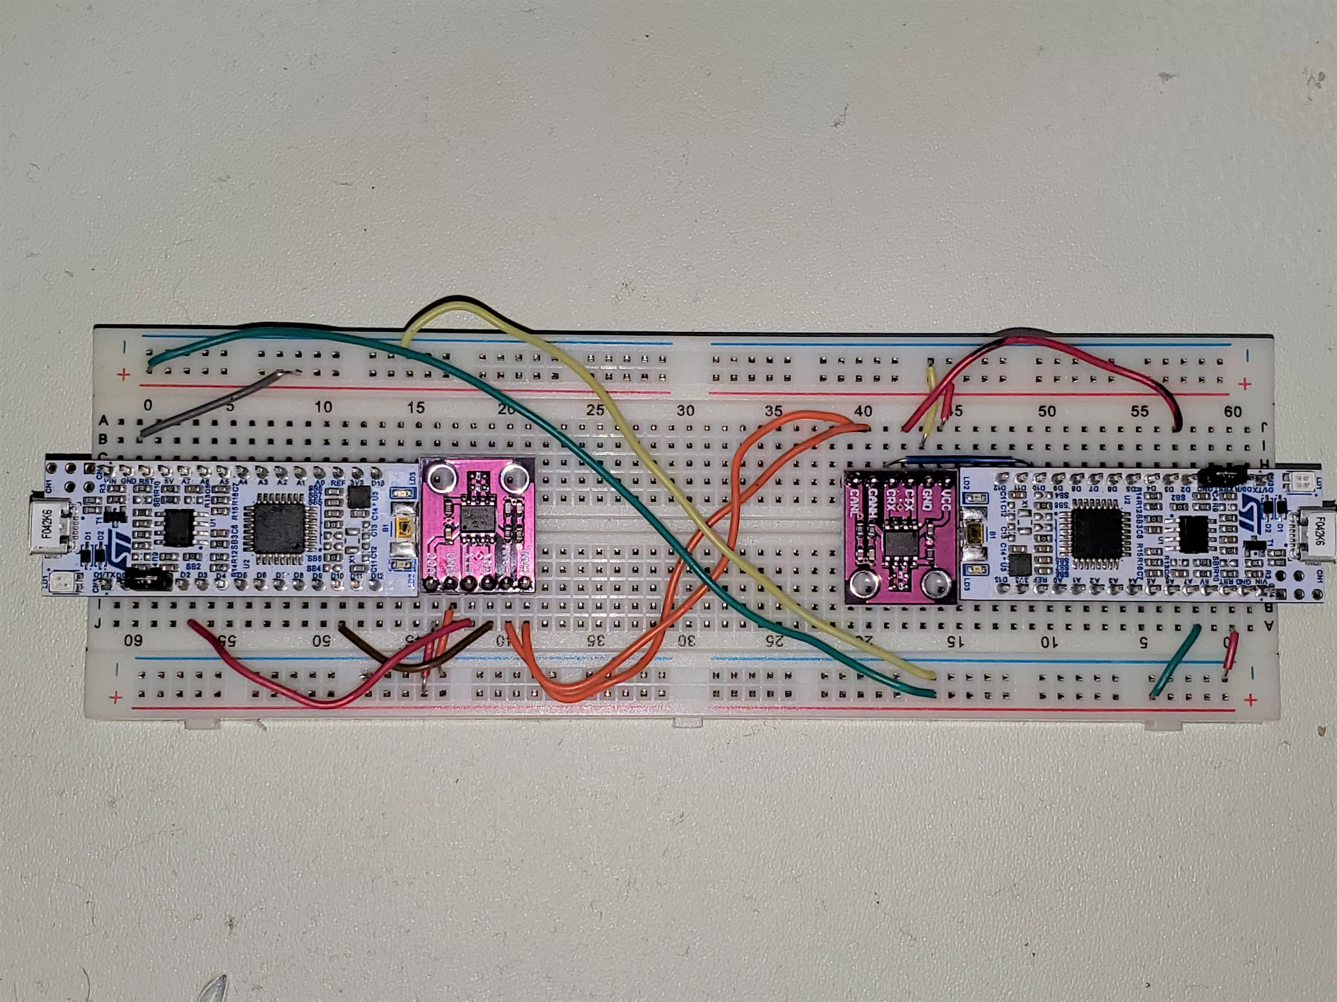
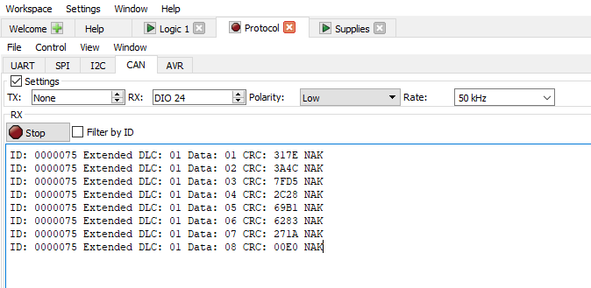
Current Status - Communications
CAN bus testing with breadboard prototype using MCP2562 transceiver
Logic analyzer capture of CAN packet

Slide 22
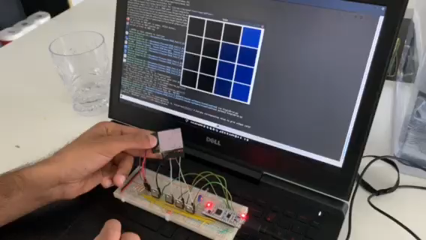
Current Status – Software
Visualization using PyQT
Parses messages from network controller
Shows sensor force location and relative magnitude

Slide 23
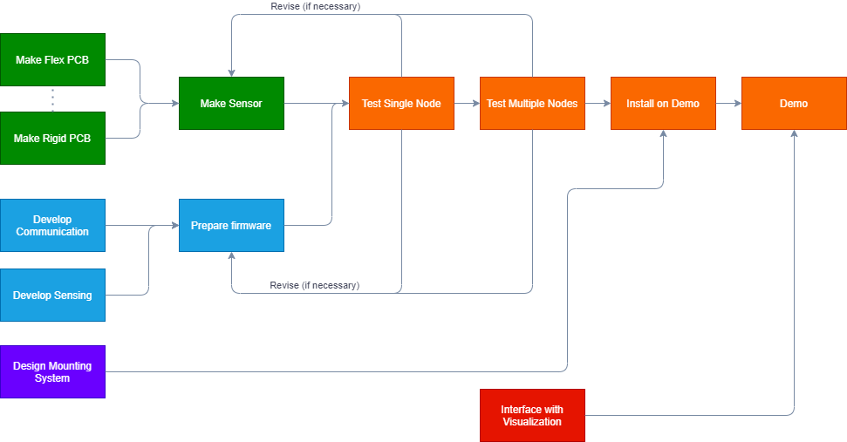
Possible Problems / Issues
Issues | Severity
Flex PCB manufacturing | ❗❗❗
General PCB turnaround | ❗❗❗
Modeling Velostat force-resistance | ❗❗
Tight time-line | ❗❗
Mbed OS compatibility issue | ❗

Slide 24
Questions?

